Slide 1
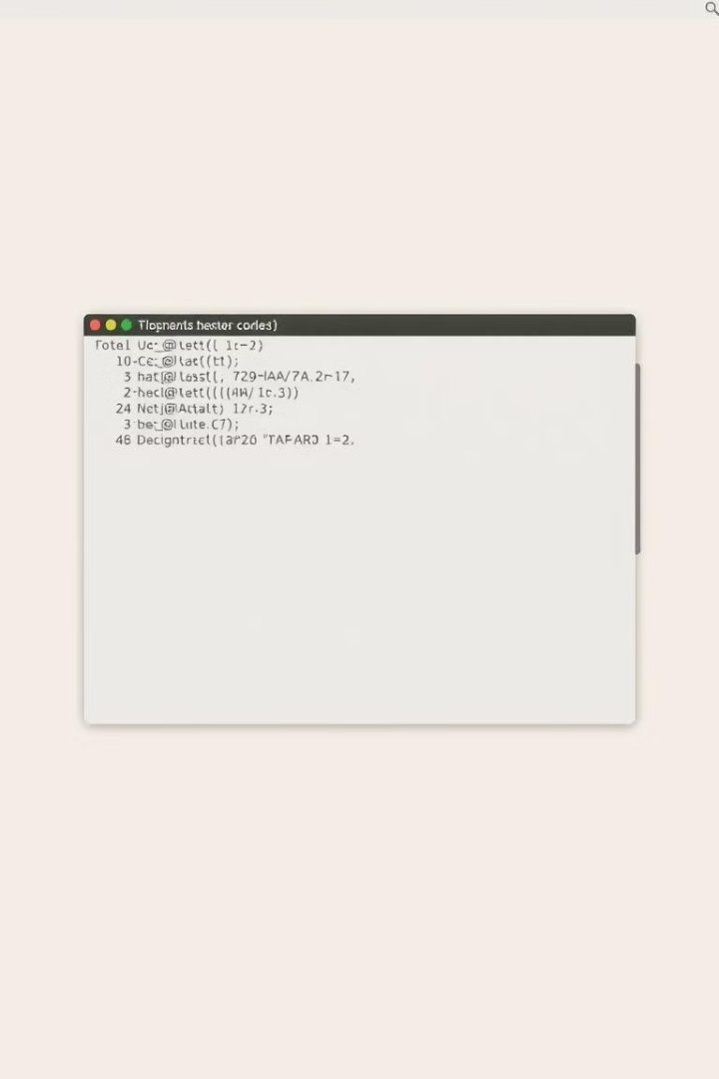
Introduction to BASH
BASH stands for Bourne-Again Shell. It's both a command-line shell and a scripting language that is widely used in Unix-like operating systems, including Linux and macOS. It's known for its efficiency in automating tasks.
Key Features:
BASH provides a text-based interface where you can type commands to interact with the operating system.
You can write scripts, which are sets of commands, to automate tasks.
It's the default shell for many Linux distributions, such as Ubuntu and Red Hat.

Slide 2
Basic Commands in BASH
ls: Lists files and directories in the current directory. ls
cd: Changes the current directory. cd /path/to/directory
pwd: Prints the working directory (shows the current directory path). pwd
echo: Displays a line of text or a variable value. echo "Hello, World!"
touch: Creates an empty file or updates the timestamp of an existing file. touch filename.txt
rm: Removes files or directories. rm filename.txt

Slide 3
Basics of Shell
Bash scripting is a type of Shell Scripting. A command line user interface that provides an interface to user to interact with OS (through commands).
What is my type shell? echo $0
To check either other shells are supported on system. cat /etc/shells

Slide 4
How to create and run the Script??
mkdir myscript
cd myscript
vi 01_basic.sh
#!/bin/bash
echo "hey Buddy!"
cat 01_basic.sh
To run the script, we can use 3 different commands, Make sure that script has rwx permissions.
./<script_name>.sh
/path/<script_name>.sh
bash <script_name>.sh
ctrl + c to terminate.
ctrl + z to stop.

Slide 5
Comments and Variables in BASH
Single line comment.
# this is a comment"
Multi line comment.
«comment ….
…..comment
Variables in Bash
How to create a variable? <Variable_name>= <Variable_value>
How to print variable? echo "$<Variable_name>"
How to store the output of one command in a variable? <Variable_name>=$<command>
Variable value can be change anytime in the script.
How to make constant variable? readonly <Variable_name>="<Variable_value>"

Slide 6
User Interaction in BASH
Method 1
Method 2
Method 3
read name
echo "Enter your name "
read -p "Enter your name : " name
echo "Your name is $name"
read name
echo "Your name is $name ."
echo "Your name is $name"

Slide 7
Conditional Statements in Bash
if-else
elif
case
This is the basic conditional statement.
Use elif to chain multiple conditions.
The case statement is useful for multiple options.
if [[ $marks -gt 40 ]]
then
echo "You are PASS"
else
echo "You are FAIL!"
fi
if [[ $marks -ge 80 ]]
then
echo "1st Division"
elif [[ $marks -ge 60 ]]
then
echo "2nd Division "
elif [[ $marks -ge 40 ]]
then
echo "3rd Division "
else
echo "You are FAIL!"
fi
echo "Select an option."
echo "a to print date."
echo "b to show list of files and directories."
echo "c to check current location."
read choice
case $choice in
a) date;;
b) ls;;
c) pwd;;
*) Invalid Input
esac
Notes:
Equal -eq/== Not Equal -nq/!= greater than -gt greater than or equal to -ge less than -lt less than or equal to -le

Slide 8
Loops in BASH
for loop
for with file
while loop
for p in {1..10}
do
echo "Hello World!"
done
var= "/path/to/file"
for name in $(cat $var)
do
echo "Name is $name"
done
count =0
num =10
while [[ $count -le $num ]]
do
echo "Value of count variable is $count"
let count++
done

Slide 9
Loops in BASH (continued)
while with file
while with .csv file
This is the test.csv file
while read myVar
create a .csv file
id,name,age
do
while IFS="," read id name image
01,Alex,23
echo "$myVar"
do
02,Jack,27
done < file_name
echo "ID is $id"
03,Tom,30
echo "Name is $name"
echo "Age is $age"
done < file_name.csv

Slide 10
Loops in BASH (continued)
Until Loop
Infinite While Loop
Infinite For Loop
a=10
until [[ $a -eq 1 ]]
do
echo "Number is $a"
let a--
done
while true
do
echo "Hello World!"
sleep 2s
done
for (( ;; ))
do
echo "Hello World!"
sleep 2s
done
Just the opposite of a while loop.

Slide 11
Functions in BASH
Block of code
Function Definition
Functions with Arguments
Functions are blocks of code that perform specific tasks when they are called. In scripts, they're invoked by name.
Way 1: function myfunction { echo "Hello World" } Way 2: myfunction(){ echo "Hello World" }
addition(){
local num1=$1
local num2=$2
let sum=$num1+$num2
echo "Sum of $num1 and $num2 is $sum"
}

Slide 12
Automate Scripting (at and crontab)
Automate your script using at command.
For one time automate:
at 21:00 10 December 2024
at> script_name
at>ctrl + d
Automate your script using crontab command.
For regular automate.
crontab -e
***** cd /home/Maryam/myscript && ./script_name
atq to check the scheduled scripts.
atrm to remove a schedule.
crontab -l to check the list of crontab scheduled scripts.
​https://crontab.guru/​

